Slide 1
Luke 5:1-11
(English Standard Version)

Slide 2
5 On one occasion, while the crowd was pressing in on him to hear the word of God, he was standing by the lake of Gennesaret, ² and he saw two boats by the lake, but the fishermen had gone out of them and were washing their nets. ³ Getting into one of the boats, which was Simon’s, he asked him to put out a little from the land. And he sat down and taught the people from the boat. ⁴ And when he had finished speaking, he said to Simon, “Put out into the deep and let down your nets for a catch.” ⁵ And Simon answered, “Master, we toiled all night and took nothing! But at your word I will let down the nets.”

Slide 3
⁶ And when they had done this, they enclosed a large number of fish, and their nets were breaking. ⁷ They signalled to their partners in the other boat to come and help them. And they came and filled both the boats, so that they began to sink. ⁸ But when Simon Peter saw it, he fell down at Jesus’ knees, saying, “Depart from me, for I am a sinful man, O Lord.” ⁹ For he and all who were with him were astonished at the catch of fish that they had taken, ¹⁰ and so also were James and John, sons of Zebedee, who were partners with Simon. And Jesus said to Simon, “Do not be afraid; from now on you will be catching men.” ¹¹ And when they had brought their boats to land, they left everything and followed him.

Slide 4
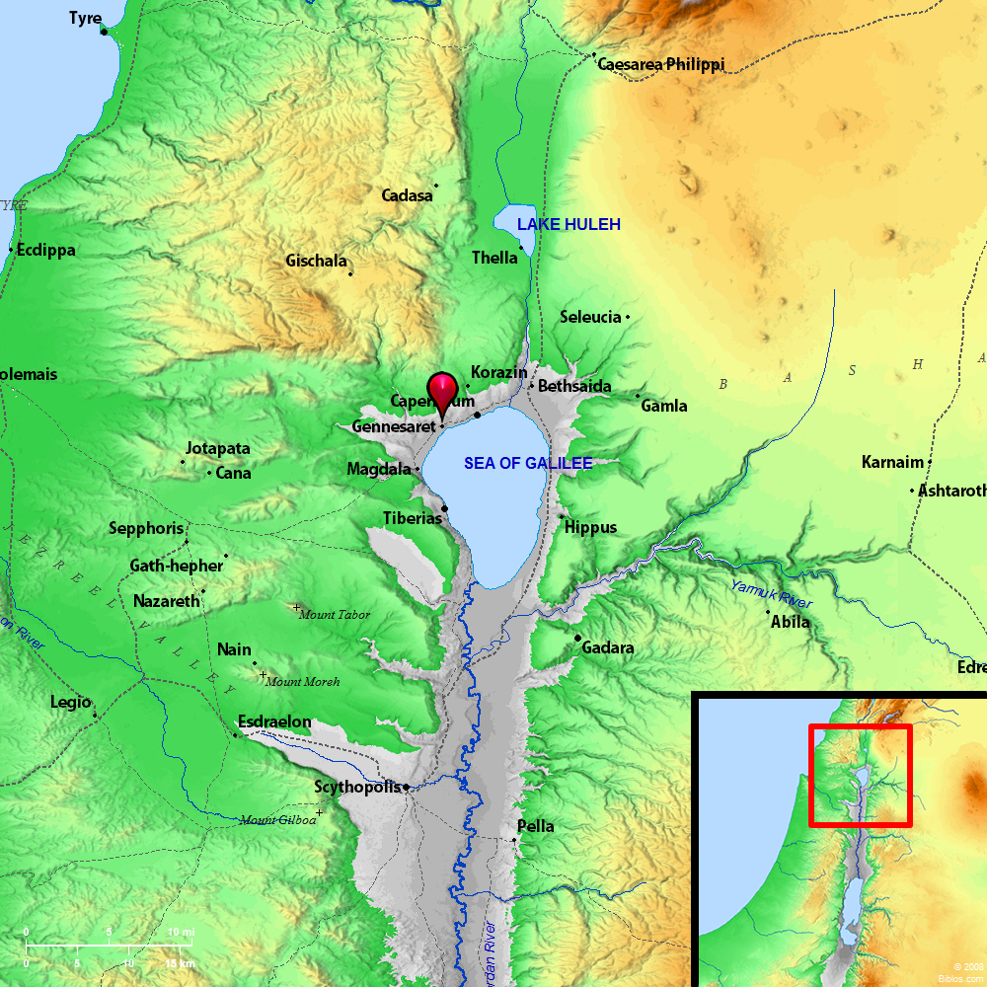

Slide 5
The Carpenter tells Professional Fisherman when to fish
Simon Peter responds as a Professional Fisherman – “We worked all night and got nothing”
Simon Peter responds in faith – “But at your word, I will let down the nets”
When we encounter the spiritual power of the Holy God:
We become aware of our own sinfulness and unworthiness.
Not fit to be in the presence and activity of Jesus.
Willingly fall at the feet of our Lord.
Seized with wonder + fear
If we don’t experience the wonder and fear of almighty God,,,,
we probably don’t know Jesus
Jesus takes those who know they are not worthy, and sets them about His Kingdom business
“Do not be afraid; from now on you will be catching men.” ¹¹ And when they had brought their boats to land, they left everything and followed him.
Not about following the path of least resistance, but following the word of Jesus
God DOES NOT only call those who have nothing, to leave everything
We are all captive to something – sin and brokenness; or set free by being captive to Jesus
Captured by Christ and given the task of catching for Christ
Moving from being an ‘onlooker’, to being a Disciple of Jesus in the true sense of the word
Follow Him; Learn from Him; Imitate Him; Personal Sacrifice in order to serve Him...

Slide 6
Onlookers. Not Disciples.
“Casting Crowns” - “Start Right Here”:
Verse 1:
We want our coffee in the lobby
We watch our worship on a screen
We got a Rockstar preacher
Who won't wake us from our dreams
We want our blessings in our pocket
We keep our missions overseas
But for the hurting in our cities
Would we even cross the street?

Slide 7
The Carpenter tells Professional Fisherman when to fish
Simon Peter responds as a Professional Fisherman – “We worked all night and got nothing”
Simon Peter responds in faith – “But at your word, I will let down the nets”
When we encounter the spiritual power of the Holy God:
We become aware of our own sinfulness and unworthiness.
Not fit to be in the presence and activity of Jesus.
Willingly fall at the feet of our Lord.
Seized with wonder + fear
If we don’t experience the wonder and fear of almighty God,,,,
we probably don’t know Jesus
Jesus takes those who know they are not worthy, and sets them about His Kingdom business
“Do not be afraid; from now on you will be catching men.” ¹¹ And when they had brought their boats to land, they left everything and followed him.
Not about following the path of least resistance, but following the word of Jesus
God DOES NOT only call those who have nothing, to leave everything
We are all captive to something – sin and brokenness; or set free by being captive to Jesus
Captured by Christ and given the task of catching for Christ
Moving from being an ‘onlooker’, to being a Disciple of Jesus in the true sense of the word
Follow Him; Learn from Him; Imitate Him; Personal Sacrifice in order to serve Him...
Am I an ‘onlooker’???? Or am I a Disciple????

